Slide 1
Principles of Drug Discovery
Lecture 5: Hit Finding
Notes:
6/12/17
1
1

Slide 2

Lecture 5c: Fragment-Based Drug Discovery

Slide 3
Let’s Review the Chemical Space
The chemical space is a concept in cheminformatics referring to the universe of molecules which are theoretically possible within a set of boundaries.
Let a molecule:
1) consist of the elements C,H,N,O and S
2) obey to the RO5
3) have at most 30 heavy atoms
4) consist at most of 4 rings
These boundaries roughly approximate the pharmacologically interesting chemical space.
The theoretical number of different molecules which fulfil these boundaries has been estimated to be in the order of 10⁶³.
So, no matter what size a screening pool has, it is much less than a single water molecule in an ocean compared to the theoretical size of the pharmacologically relevant chemical universe.

Slide 4
Number of molecules typically screened in an HTS: ~ 10⁶
Size of the chemical space for drug-like molecules: ~ 10⁶⁰
So, what we typically screen is in the order of 0.0000000000000000000000000000000000000000000000000000000001 % of the total chemical space for drug-like molecules.

Slide 5
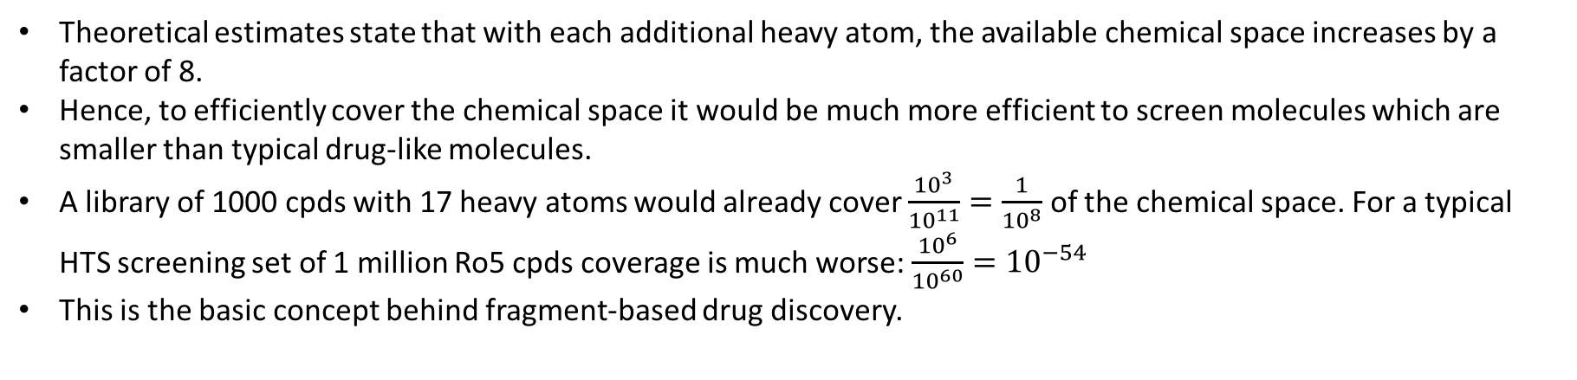
The Chemical Space as a Function of Molecule Size
GDB 17 was a project with a goal to systematically enumerate the chemical space which is possible with 17 heavy atoms (C,N,O,S,halogens). It delivered 166.4 billion unique structures (~10¹¹)
Theoretical estimates state that with each additional heavy atom, the available chemical space increases by a factor of 8.
Hence, to efficiently cover the chemical space it would be much more efficient to screen molecules which are smaller than typical drug-like molecules.
A library of 1000 cpds with 17 heavy atoms would already cover $\frac{{10}^{3}}{{10}^{11}}=\frac{1}{{10}^{8}}$ of the chemical space. For a typical HTS screening set of 1 million Ro5 cpds coverage is much worse: $\frac{{10}^{6}}{{10}^{60}}={10}^{−54}$
This is the basic concept behind fragment-based drug discovery.

Slide 6
The Modular View of Binding Sites
Most binding sites provide several interaction hotspots which are essential to achieve high affinity
For molecules of drug-like size the probability have the right chemical groups in the right geometric arrangement while at the same time not clashing with parts of the protein is very low
For smaller, fragment-like molecules the probability to bind to a favorable interaction site is substantially higher. However, the binding affinity is much lower.

Slide 7
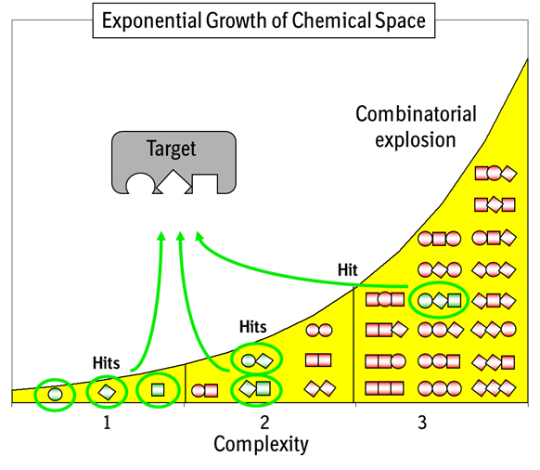
The probability to find a molecule which binds to a target decreases rapidly with molecule size.

Slide 8
Fragments
In analogy to the rule of five (Ro5) fragments are usually defined by the rule of three:
MW < 300
logP < 3
# Hdonors not greater than 3
# Hacceptors not greater than 3
Also this rule is not to been seen as carved in stone. Fragments need to be screened at higher concentrations than HTS cpds, which means they must be soluble at high concentrations.

Slide 9
The idea behind Fragment-Based Drug Discovery (FBDD) is that screening of smaller molecules provide a much better coverage of the chemical space than screening of drug-like molecules.
However, even if a fragment forms favorable interactions with a target its affinity is usually in a range from micromolar to millimolar, which is 2-3 orders of magnitude lower than good HTS hits.
This poses substantial challenges on the experimental setup and the fragments which are used for screening:
Fragments need to be highly soluble and resistant towards aggregation
The screening assays have to be very sensitive for low affinity binders

Slide 10
Fragment Screening Assays
Due to the special requirements of hit finding with fragments a number of specialized technologies have been developed which are now commonly employed in industrial drug discovery. The most important technologies are:
STD-NMR
SPR
Thermal Shift Assays
Microscale Thermophoresis

Slide 11
STD-NMR
Saturation-Transfer-Difference
Protons in proteins can be selectively saturated by irradiation with specific wavelengths
When a ligand is in close proximity to the protein saturation will also spread on the ligand (NOE)
If there is a difference between the ”off resonance” spectrum of the ligand and the “on resonance” spectrum this indicates binding

Slide 12
Surface Plasmon Resonance (SPR)

Slide 13
Thermal Shift Assay

Slide 14
Microscale Thermophoresis

Slide 15
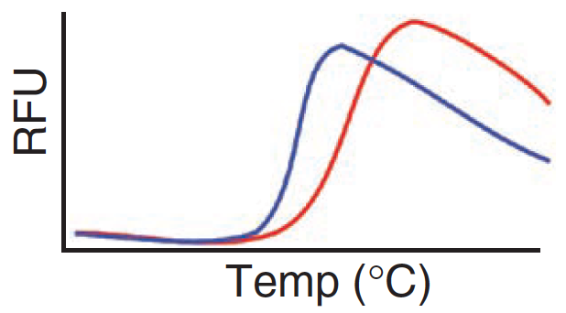
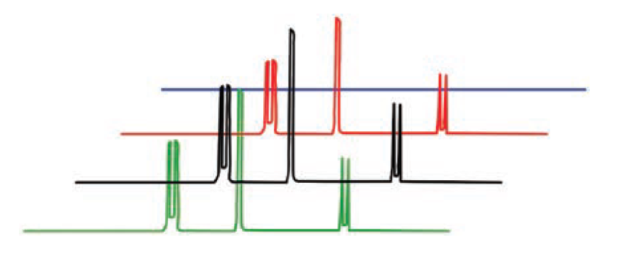
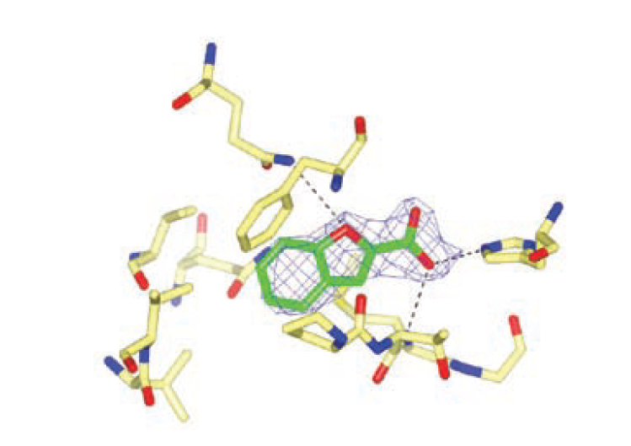
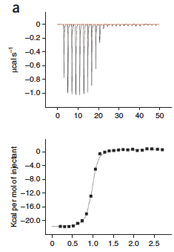
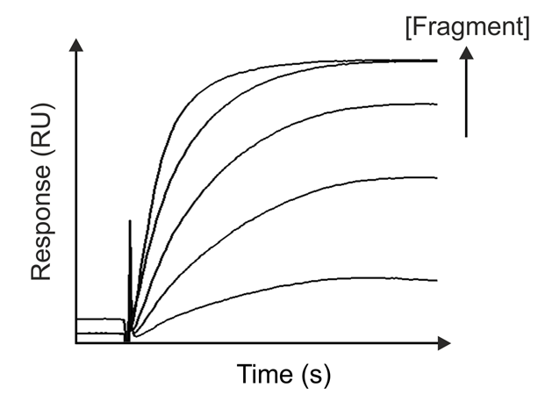
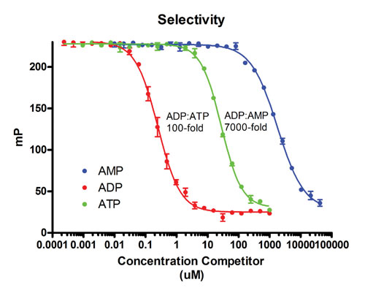
Target Protein
Thermal Shift
Primary Screening
Thermal Shift / SPR / NMR
NMR
Secondary Screening
NMR Spectroscopy
X-Ray
ITC
Binding Affinity
ITC / SPR/ FP
SPR
FP
Notes:
Expressible and stable protein

Slide 16
FBS Strategy
Like all assay systems FBS assays yield false positives and false negatives.
Therefore combinations of assay systems are used to increase confidence in delivered hits
Assay 1
Assay 2
Assay 3
Hits found in all assays
The most promising hits are selected for X-ray crystallography

Slide 17
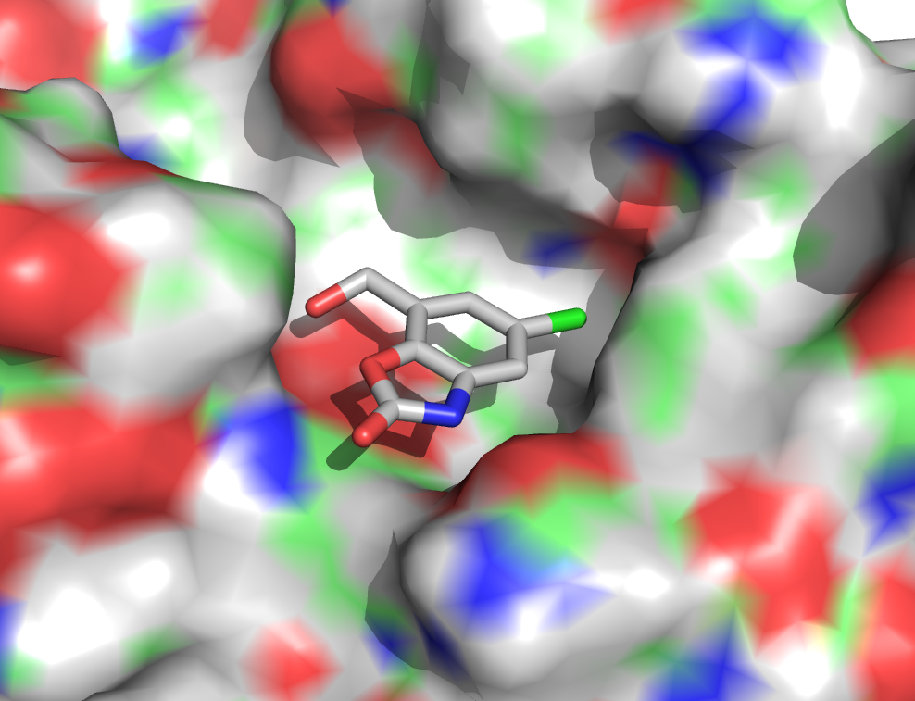
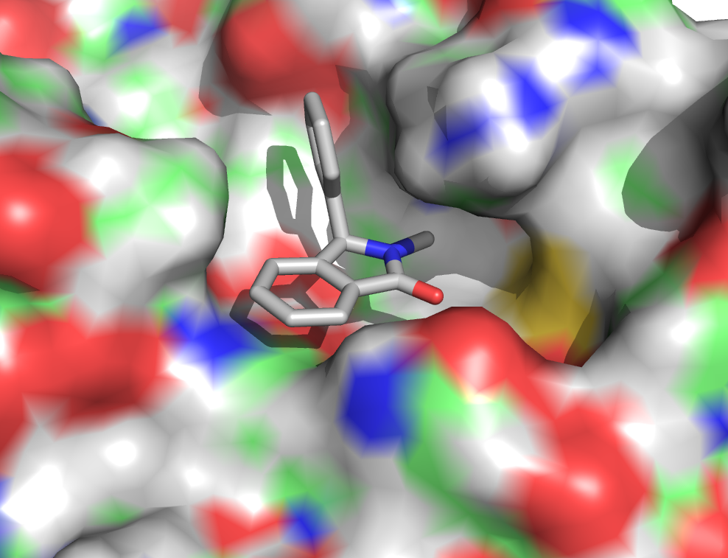
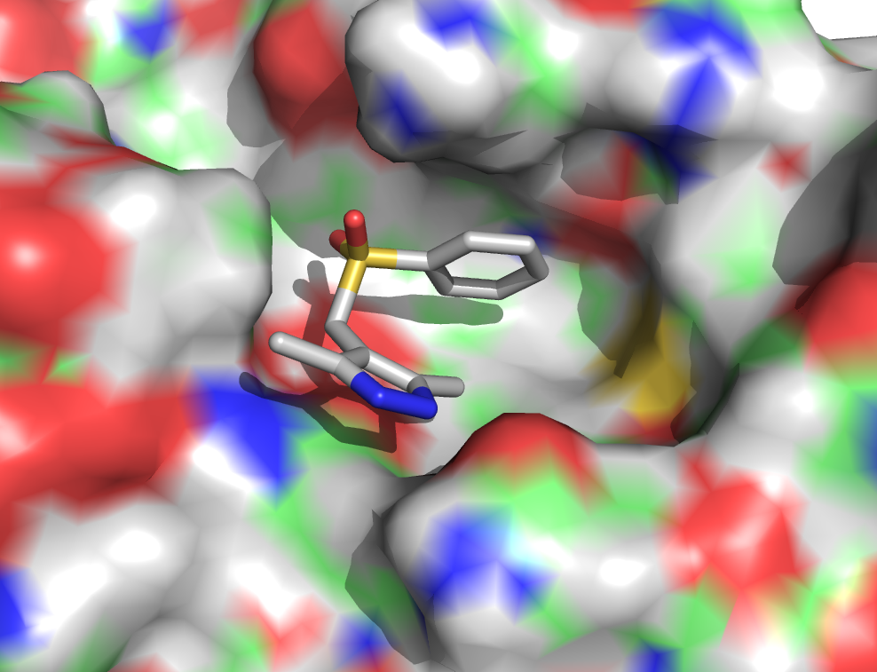
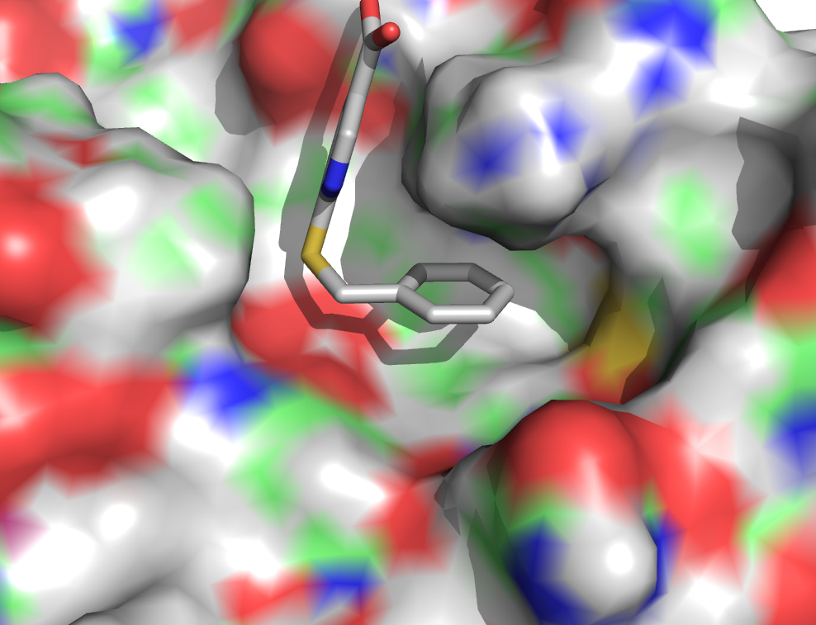
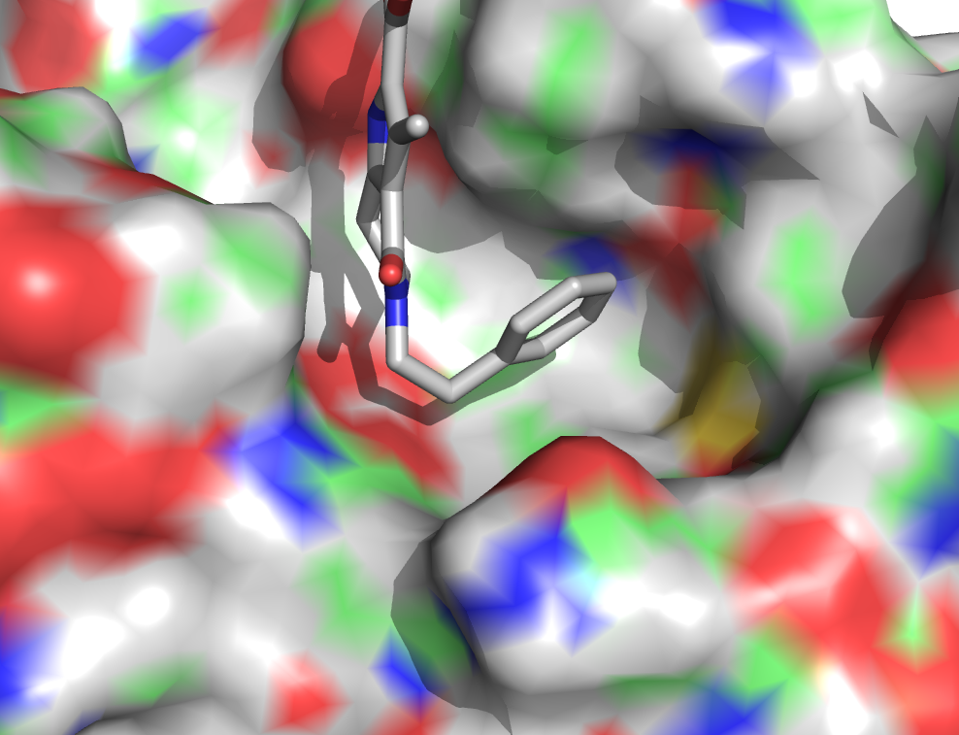
Xray Hits From a Fragment Screen

Slide 18
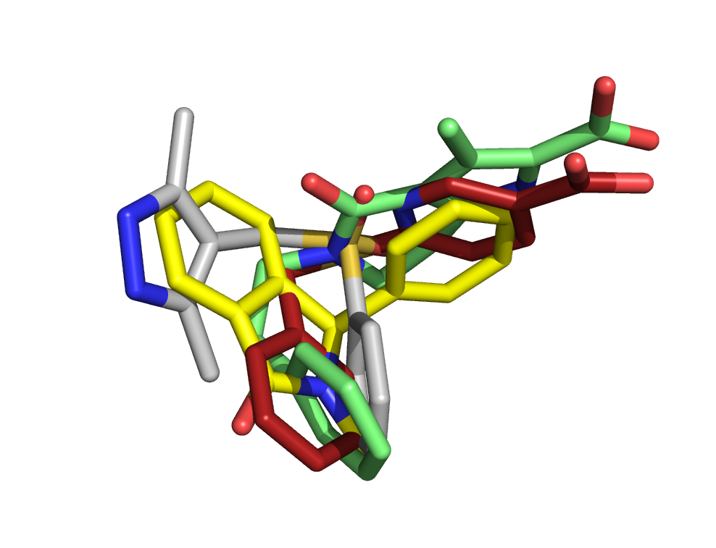
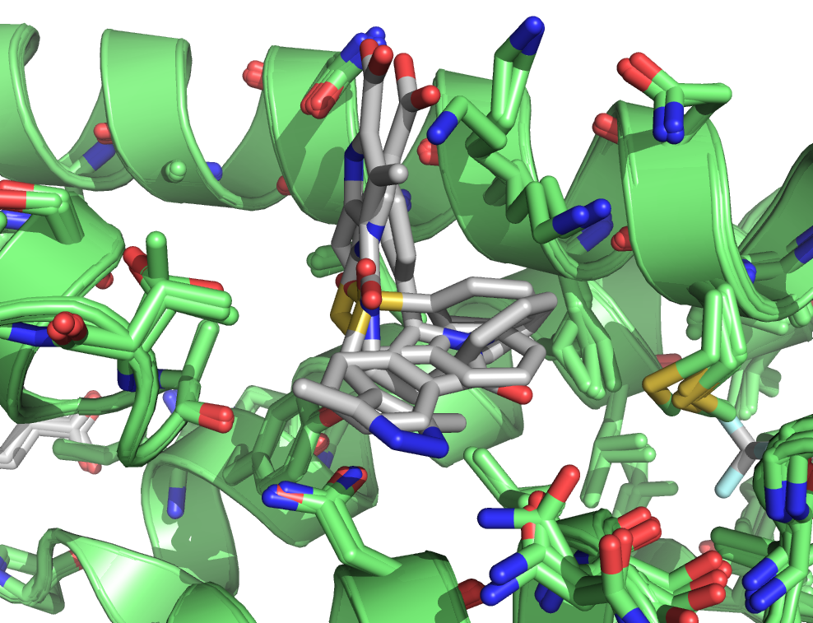
Xray Hits From a Fragment Screen
Fragments form different interactions with the protein and occupy different parts of the binding site

Slide 19
Fragment Follow-Up
There are different strategies to follow-up on fragment hits
Fragment-Growing
Fragment-Merging
Fragment-Linking

Slide 20
Fragment-Growing
Fragment-Growing requires analysis of the fragment binding pose and the identification of ways to form additional interactions with the protein.
Fragment A
Enzyme
Enzyme

Slide 21
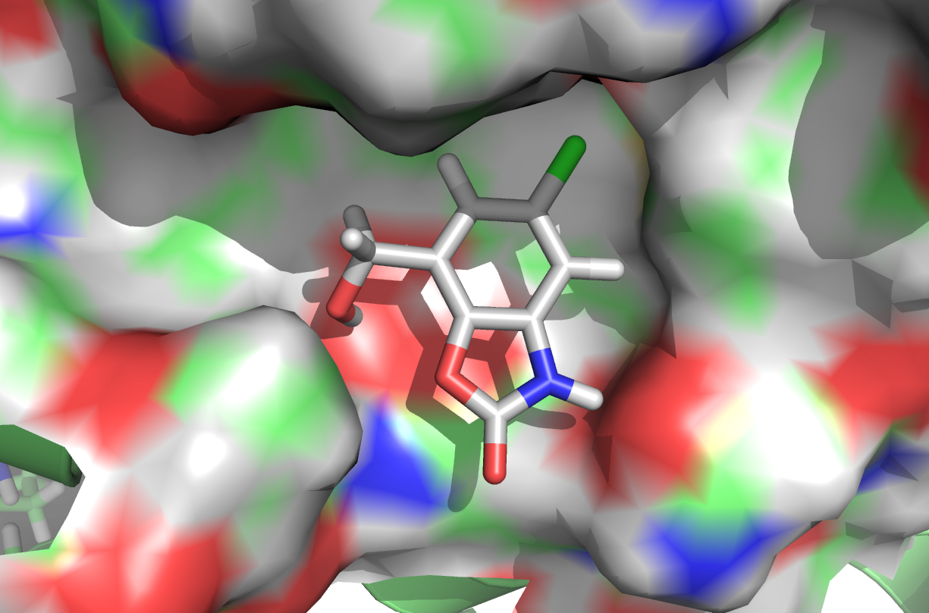
Fragment-Growing
Opportunity to grow

Slide 22
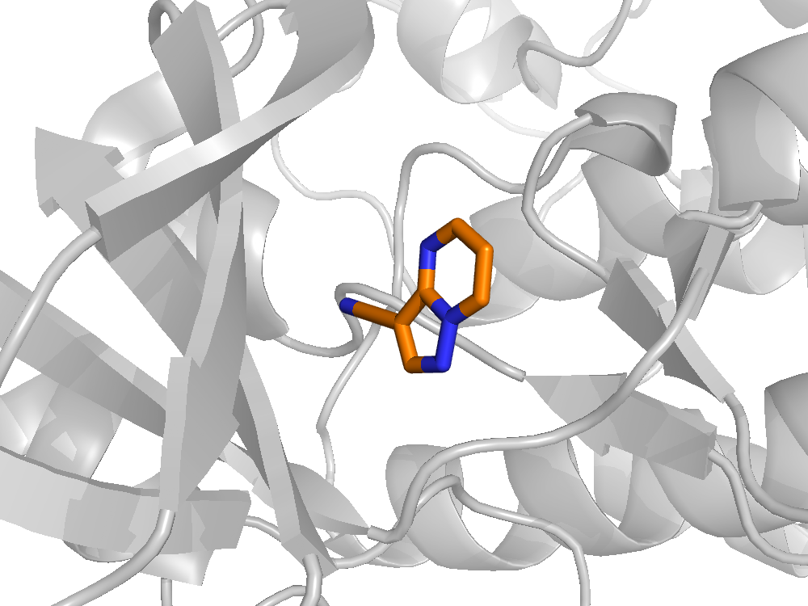
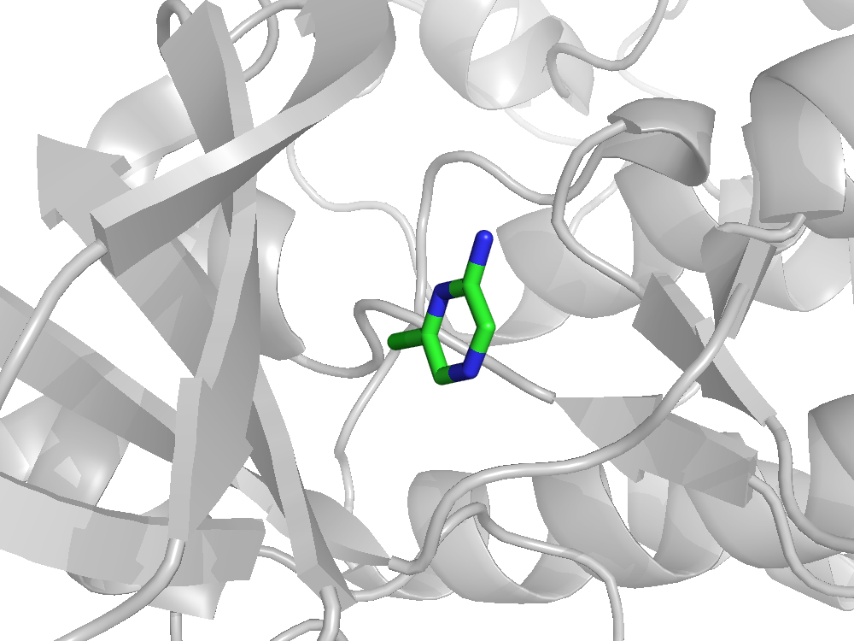
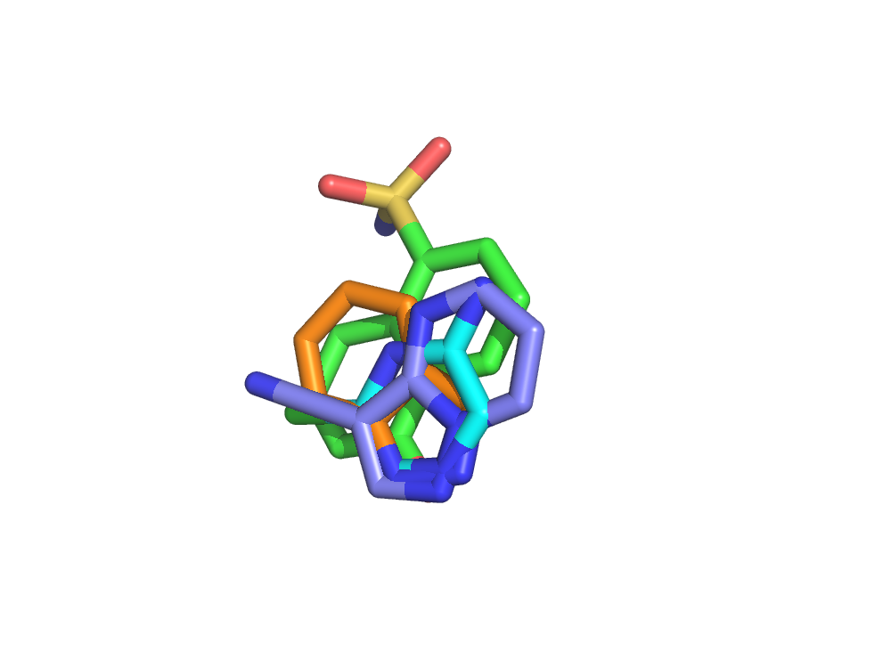
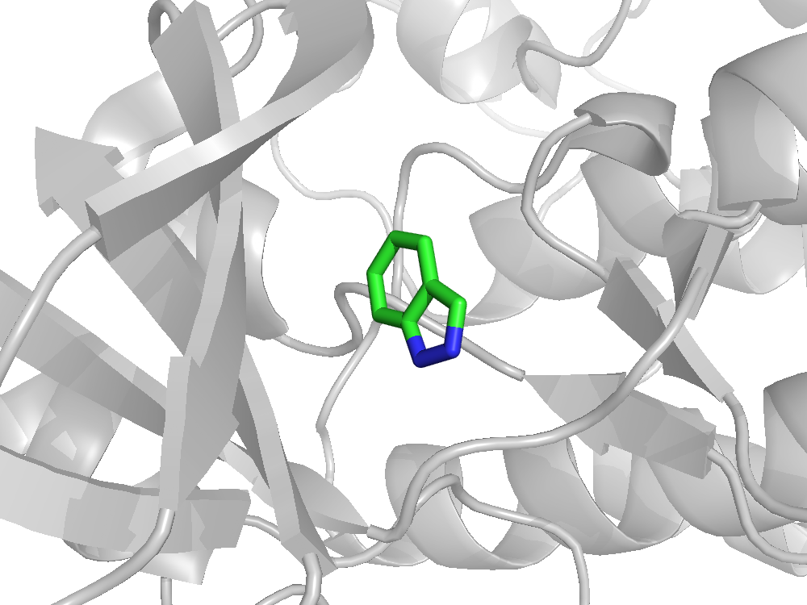
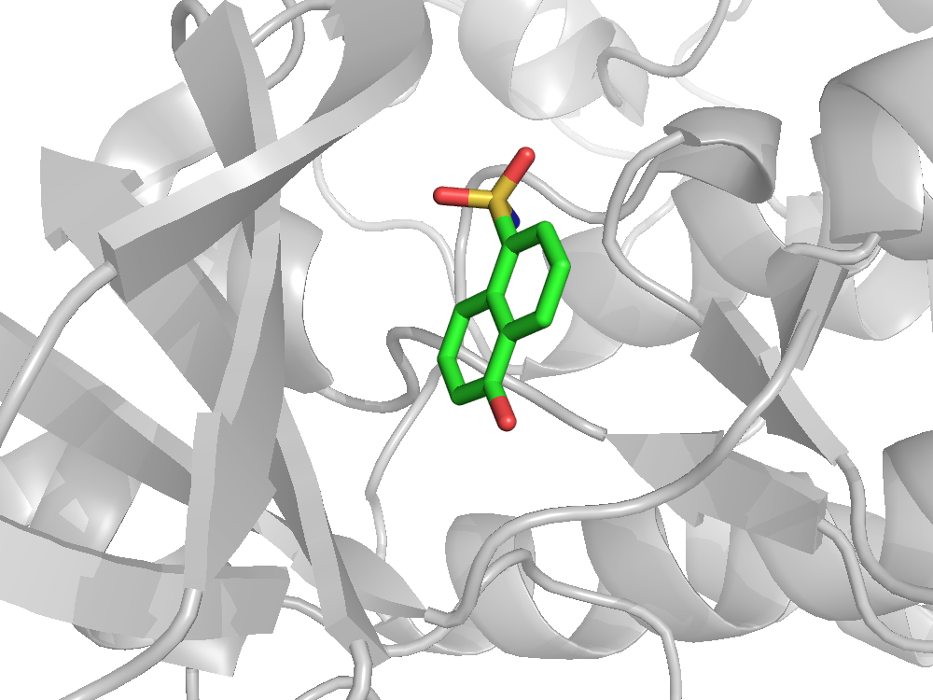
Fragment Growing - Kinases
%I 54% (1 mM)
%I 64% (1 mM)
IC₅₀ 0.185 mM
IC₅₀ 0.120 mM

Slide 23
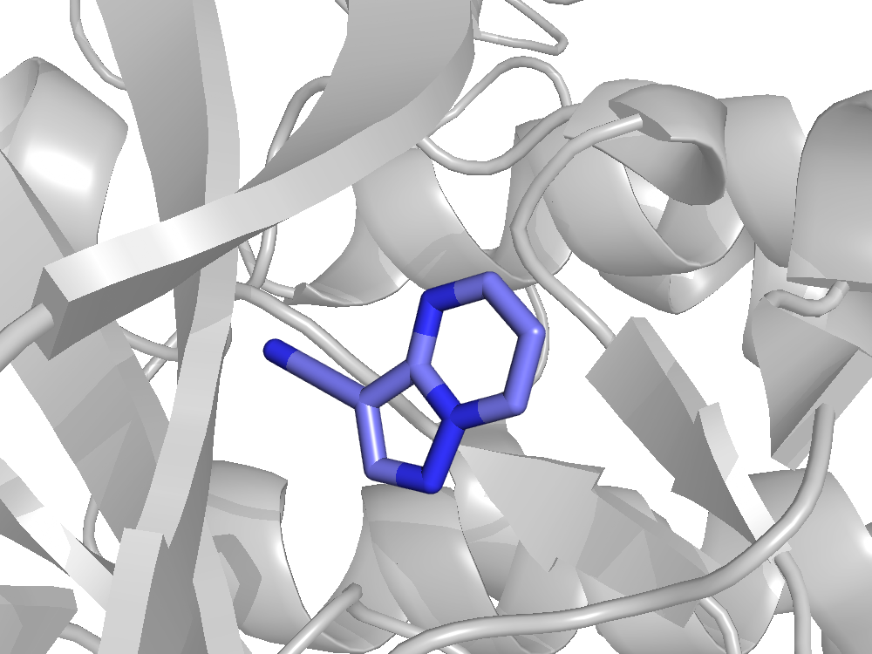
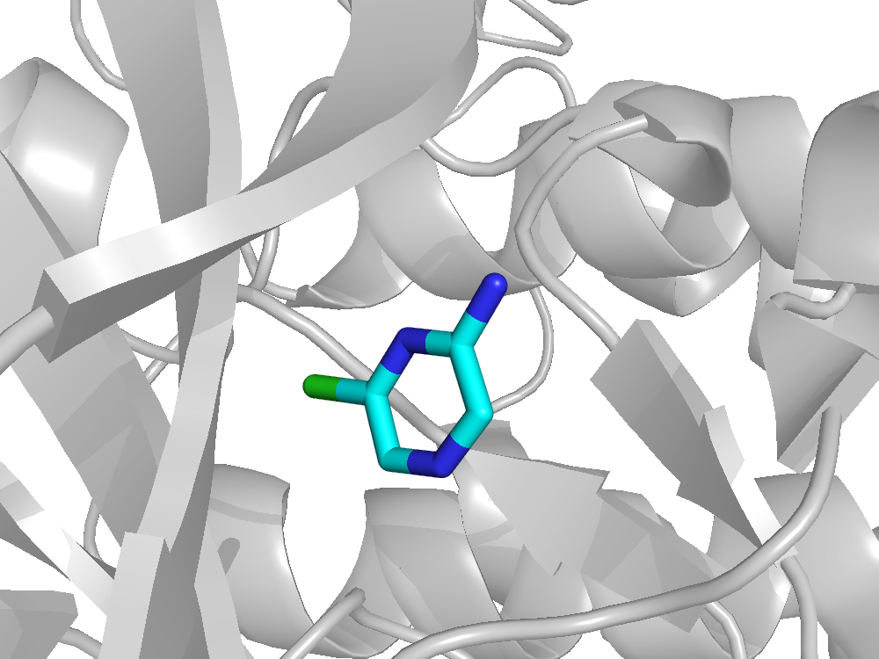
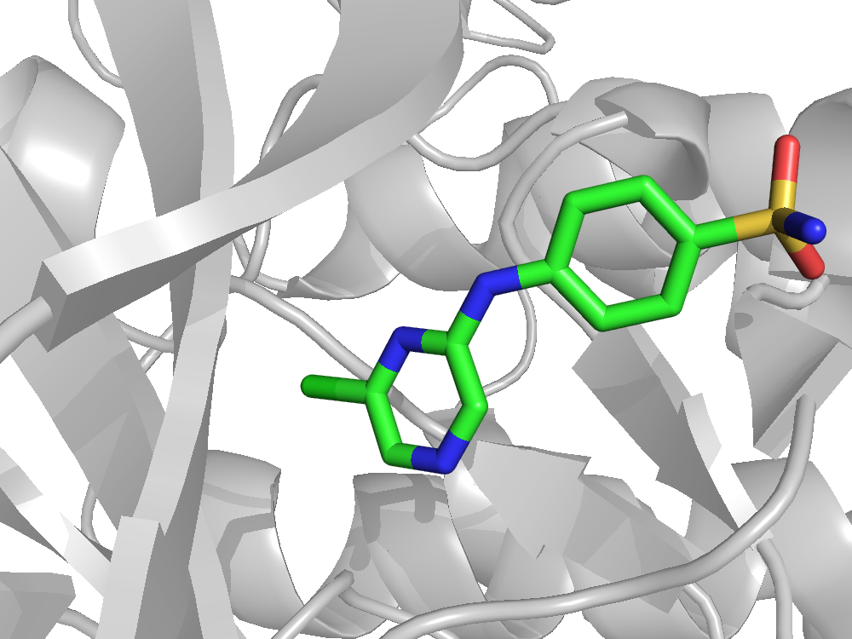
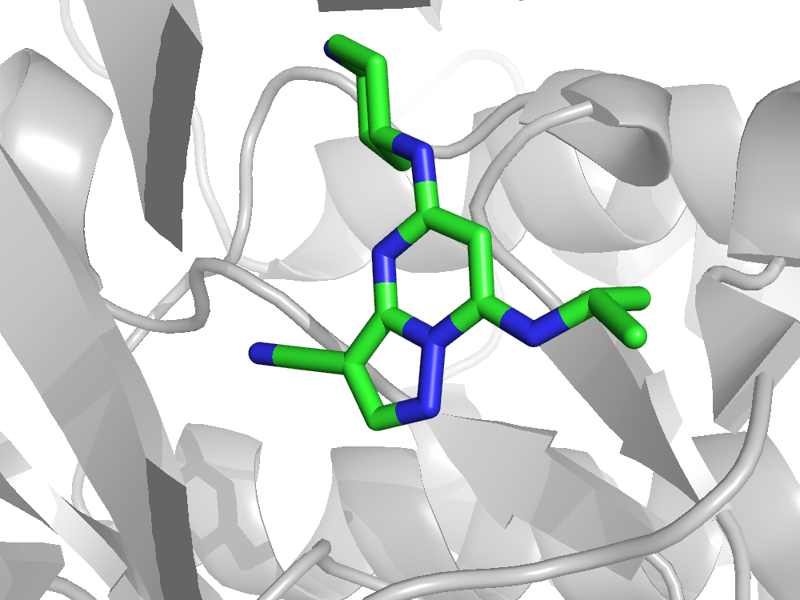
Fragment Growing – CDK Series 1 and 2
Series 1
Series 2
%I 64% (1 mM)
%I 54% (1 mM)
IC₅₀ 7 μM
IC₅₀ 1.6 μM
IC₅₀ 1.9 μM
IC₅₀ 30nM
Series discontinued as optimisation below low micromolar is not straightforward (LE not maintained through optimisation)
Series discontinued as while it showed good cellular activity did not show good in-vivo activity

Slide 24
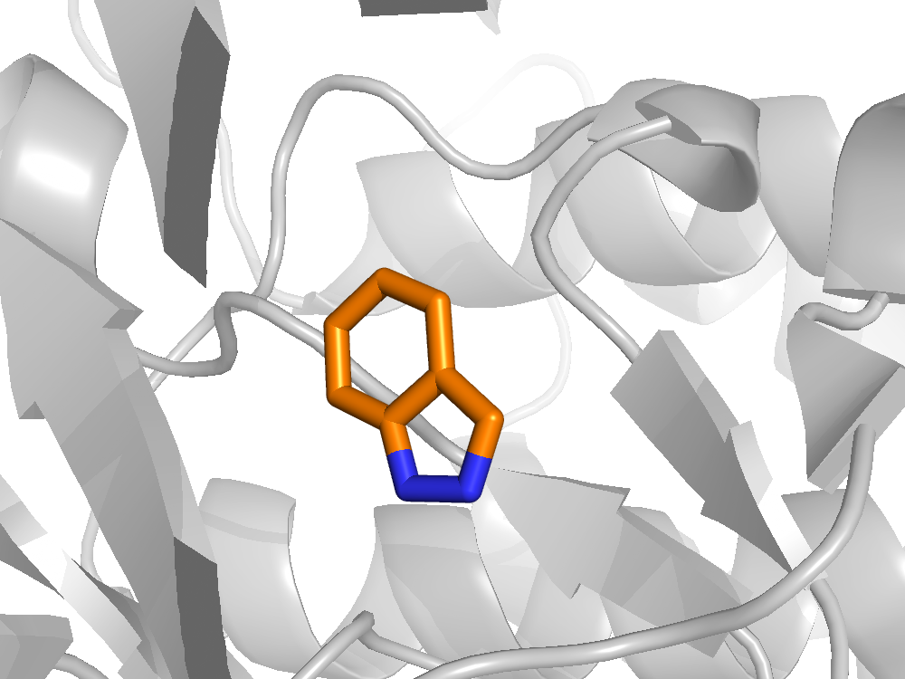
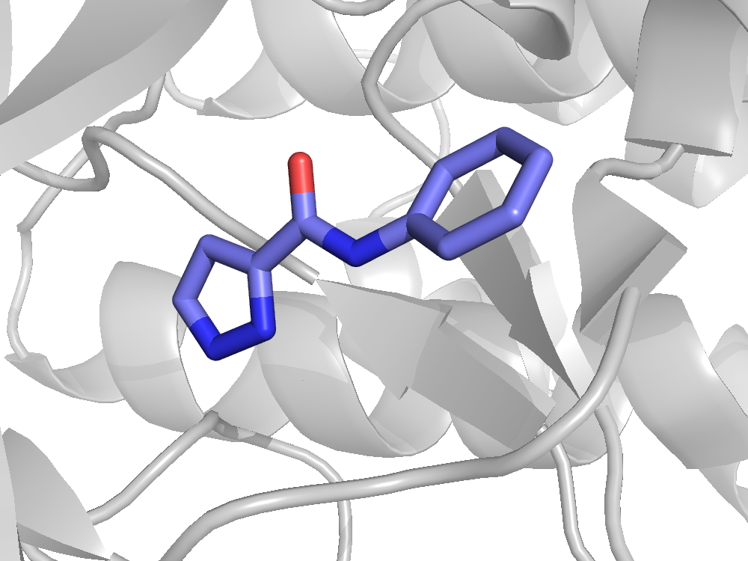
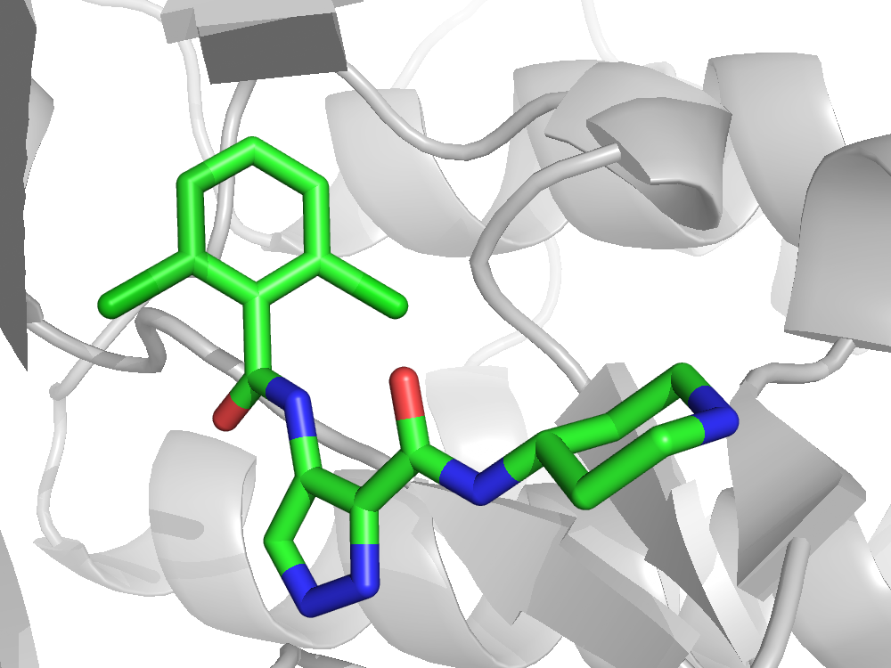
Fragment Growing – CDK Series 3
Series 3
IC₅₀ 185 μM
LE 0.57
IC₅₀ 3 μM
LE 0.42
IC₅₀ 97 μM
LE 0.39
IC₅₀ 3 nM
LE 0.45
IC₅₀ 47 nM
LE 0.40
AT7519
Fragment growing of the initial indazole hit led to a compound with a 50 fold increase in potency. Removal of the phenyl ring of the indazole offered a new startpoint and this was subsequently elaborated to a compound with a IC₅₀ of 47 nM with only a small drop in LE (AT7519)
Interestingly the piperidine is protruding out of the pocket toward solvent and the two chlorine atoms in the 2 and 6 position of the phenyl ring fill small hydrophobic pockets on the protein
AT7519 is currently in Phase II clinical trials and has shown good indications against a range of human tumor cell lines
The structure of AT7519 makes amenable to scale-up which is important in the later stage clinical trials

Slide 25
Fragment-Merging
Fragment-Merging is the attempt to combine two overlapping fragments into one molecule.
Fragment B
Merged
fragment
Fragment A
Enzyme
Enzyme

Slide 26
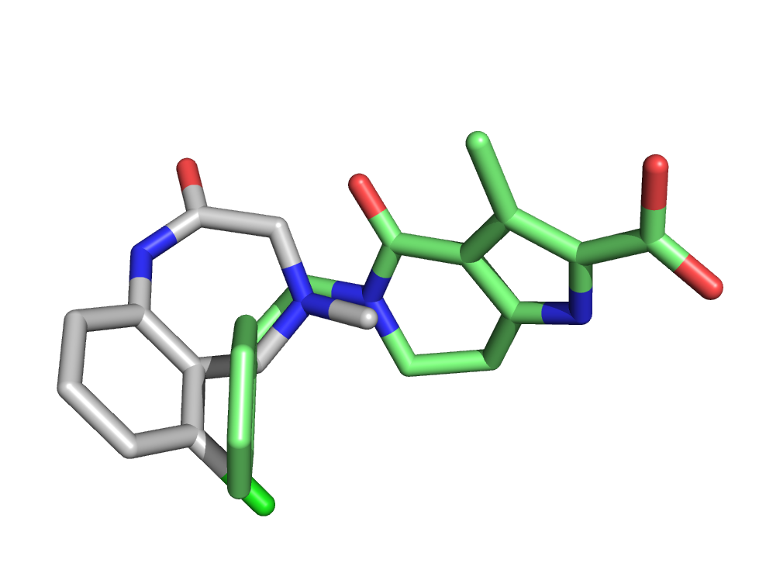
Fragment-Merging
Overlapping bond/Exit vector

Slide 27
Fragment Merging – CYP121 (M. tuberculosis)
CYP121
Fragment Library
665 Fragments
665 Fragments
K_{D} = 0.40 mM
LE = 0.39
Primary Screening
Thermal Shift (Hit > 0.8ºC)
66 Fragments
(55 Fragments NMR)
9.9 % Hit rate
Secondary Screening
NMR Spectroscopy
(WaterLOGSY, CPMG and STD)
K_{D} = 1.60 mM
LE = 0.29
26 Fragments
(cYY Displaced)
(3.9% Hit rate)
X-Ray Crystallography
Isothermal titration calorimetry (ITC)
K_{D} = 0.27 mM
LE = 0.35
5 Fragments
K_{D} = 3.0 mM
LE = 0.26
Fragment screening against CYP121 yielded 5 fragments that were chosen to be carried forward for elaboration
The K_{D} of these fragments were in the range of between 0.27-3.0 mM which is typically expected for fragment binding
The ligand efficiency (LE) of these fragments was good
How are these fragments binding to CYP121?
K_{D} = 1.70 mM
LE = 0.32
Hudson S.A. et al, Angew. Chem. Int. Ed, 2012, 51, 9311-9316

Slide 28
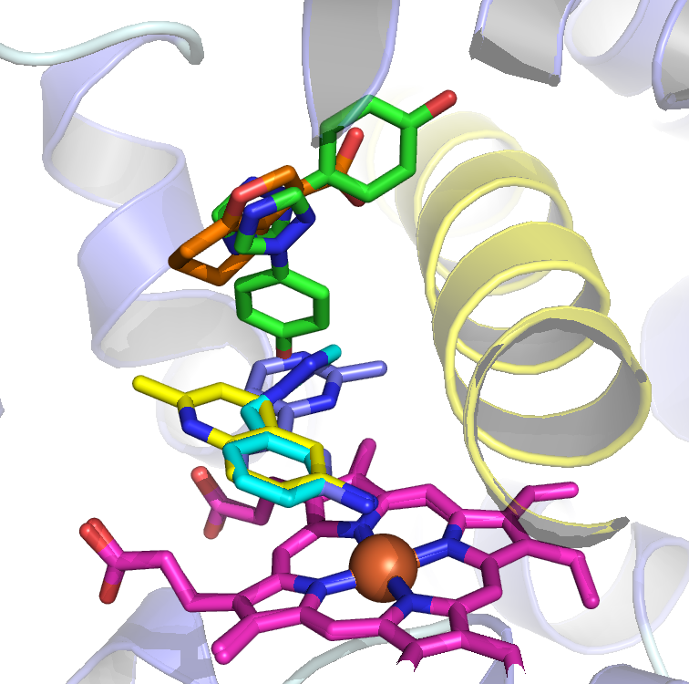
Fragment Merging – CYP121 (X-Ray Crystallography)
Non-heme binder however shows two distinct binding poses in the X-Ray crystal structure
Fragment Merging
Non-heme binder. Merge with the triazole fragment
Heme binder through NH₂
Difficult to merge with other fragments
Heme binder through NH₂
Fragment Merging of the two compounds together
Two distinct binding regions in CYP121 where fragments bind to the heme iron or further up the pocket. There are a number of possible fragment merging strategies possible to increase potency
Hudson S.A. et al, Angew. Chem. Int. Ed, 2012, 51, 9311-9316

Slide 29
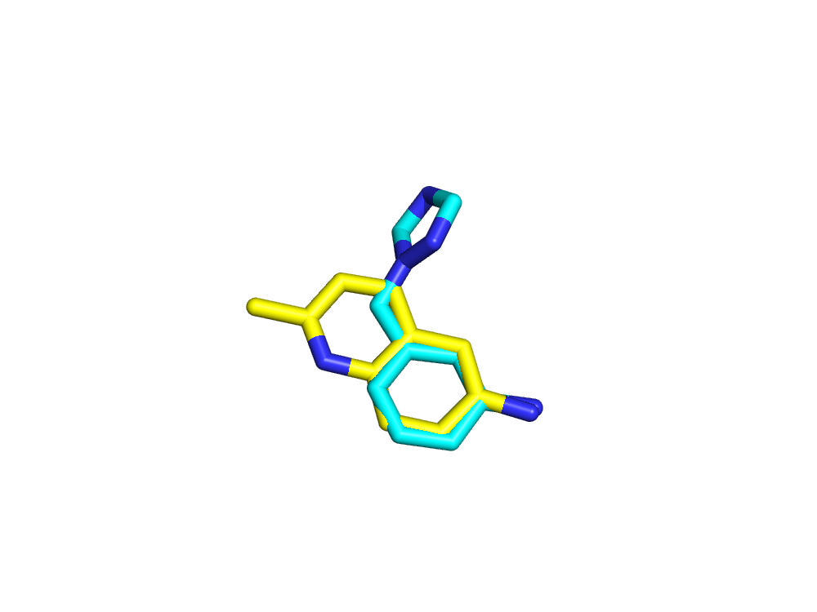
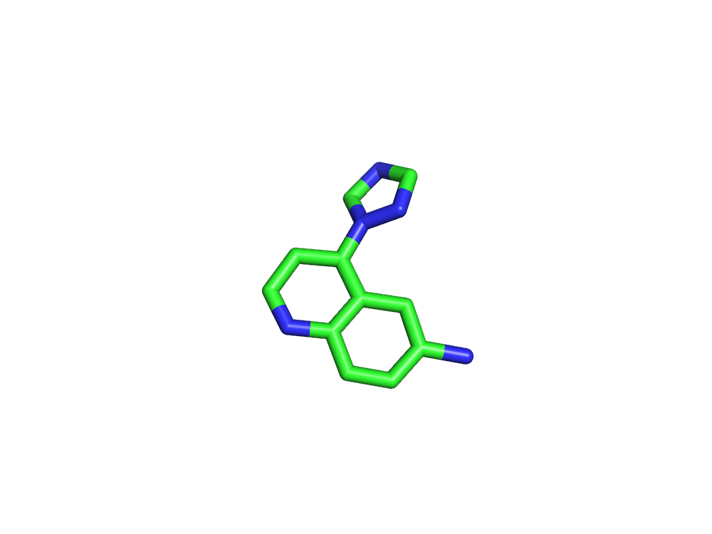
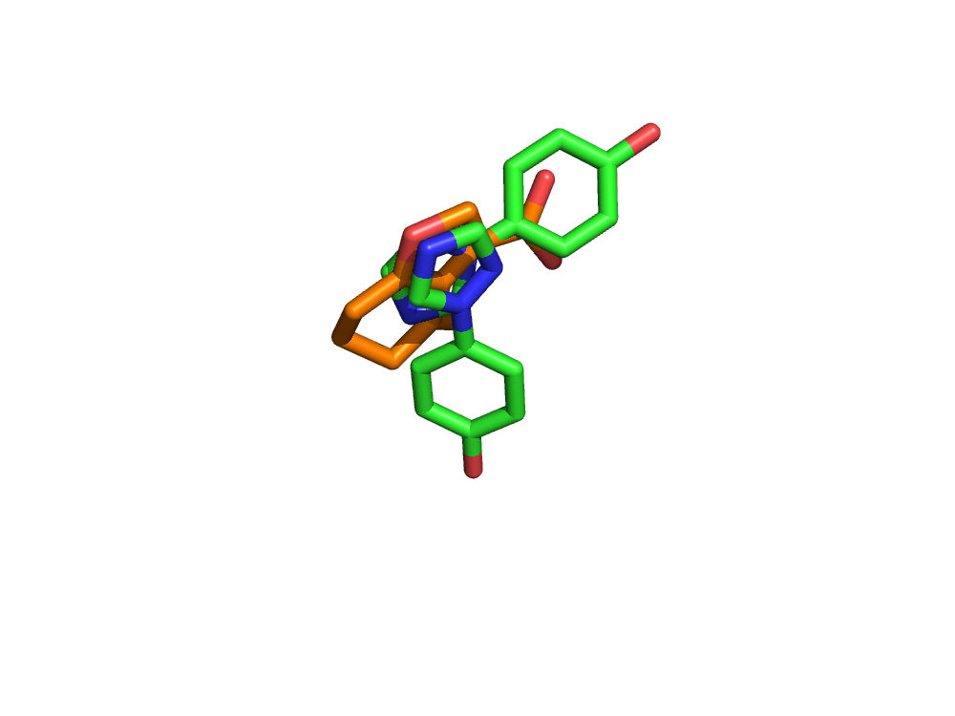
Fragment Merging – CYP121 (M. tuberculosis)
Strategy 1 (Heme binders)
K_{D} = 0.40 mM
LE = 0.39
K_{D} = 1.60 mM
LE = 0.29
K_{D} = 28 μM
LE = 0.39
Increase in potency when the two fragments are merged together.
Overlap in X-ray crystal structure on merged compound shows almost identical overlay with original fragments.
Ligand efficiency is maintained
Strategy 2 (Non-heme binders)
K_{D} = 1.7 mM
LE = 0.32
K_{D} = 3.0 mM
LE = 0.26
No binding observed
Merging of these two compounds gave no increase in potency and had the opposite effect where no binding was observed for the merged compounds.
Unsuccessful merging strategy
Hudson S.A. et al, Angew. Chem. Int. Ed, 2012, 51, 9311-9316

Slide 30
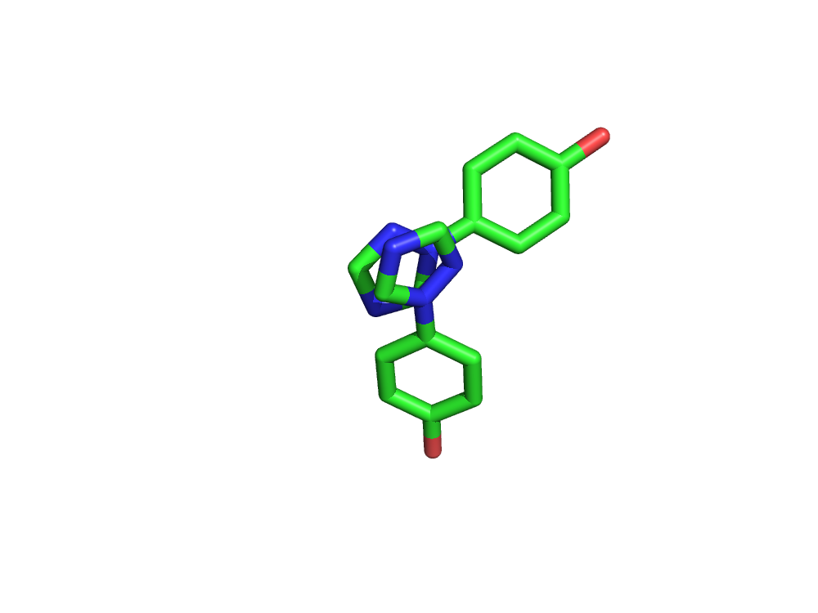
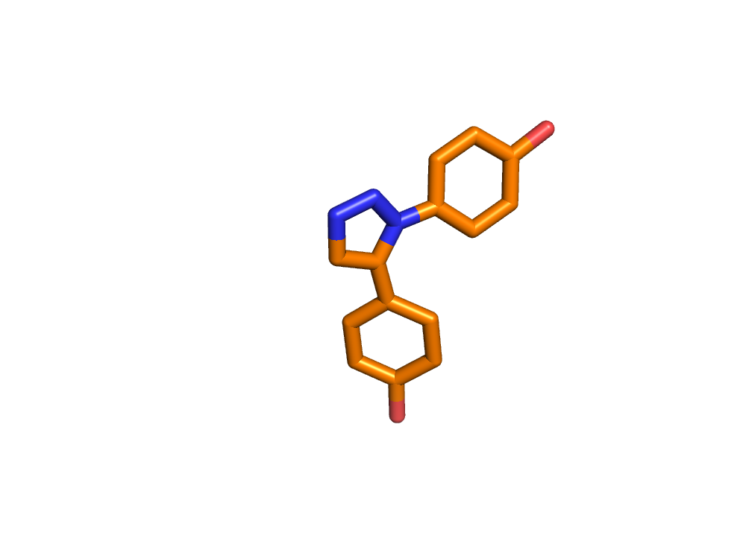
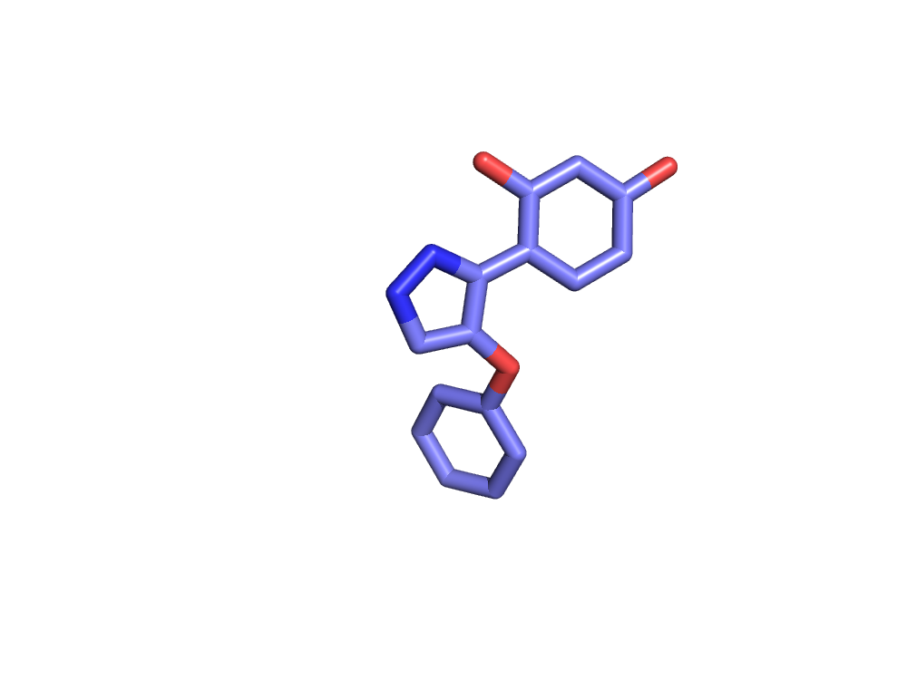
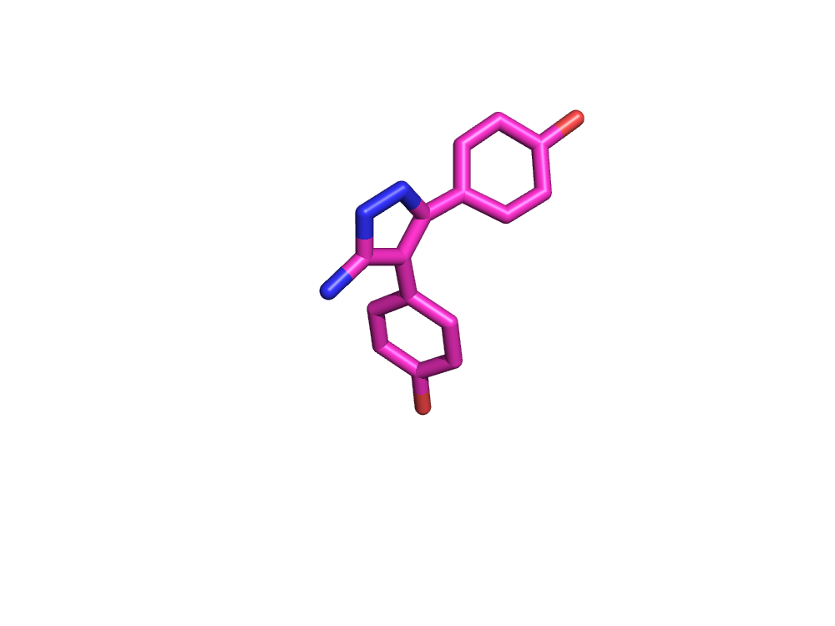
Fragment Merging – CYP121 (M. tuberculosis)
Strategy 3 (Non-heme binder)
K_{D} = 1.7 mM
LE = 0.32
K_{D} = 2.8mM
LE < 0.20
K_{D} = 0.50 mM
LE = 0.24
K_{D} = 40 μM
LE = 0.30
Merging of the two poses of the 1,2,4-triazole into a 1,5 disubstituted 1,2,3-triazole gave a compound which bound in a similar pose as the initial fragment hit however the potency was much poorer
Further elaboration of the triazole ring to a pyrazole and subsequently an aminopyrazole had a significant effect on the potency where this increased to 40 μM with a slight drop in ligand efficiency.
Successful merging strategy however further elaboration needed in order to increase the potency
With the three strategies in CYP121 only one gave an increase in potency where the fragments were directly merged
Hudson S.A. et al, Angew. Chem. Int. Ed, 2012, 51, 9311-9316
Hudson, S.A., et al, ChemMedChem, 2013, 8, 1451-1455

Slide 31
Fragment-Linking
Fragment-linking is the attempt to connect two fragments which bind in a non-overlapping manner with a linker.
Fragment B
Fragment B
Fragment A
Fragment A
Enzyme
Enzyme

Slide 32
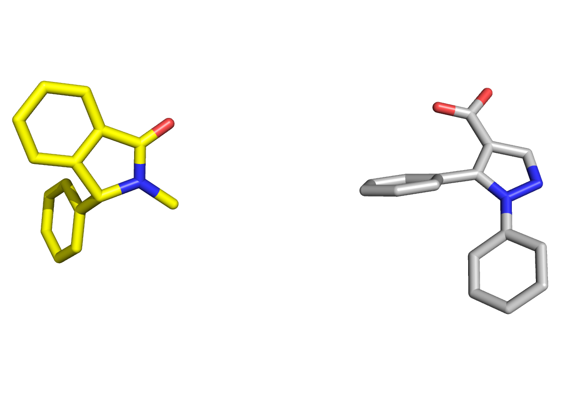
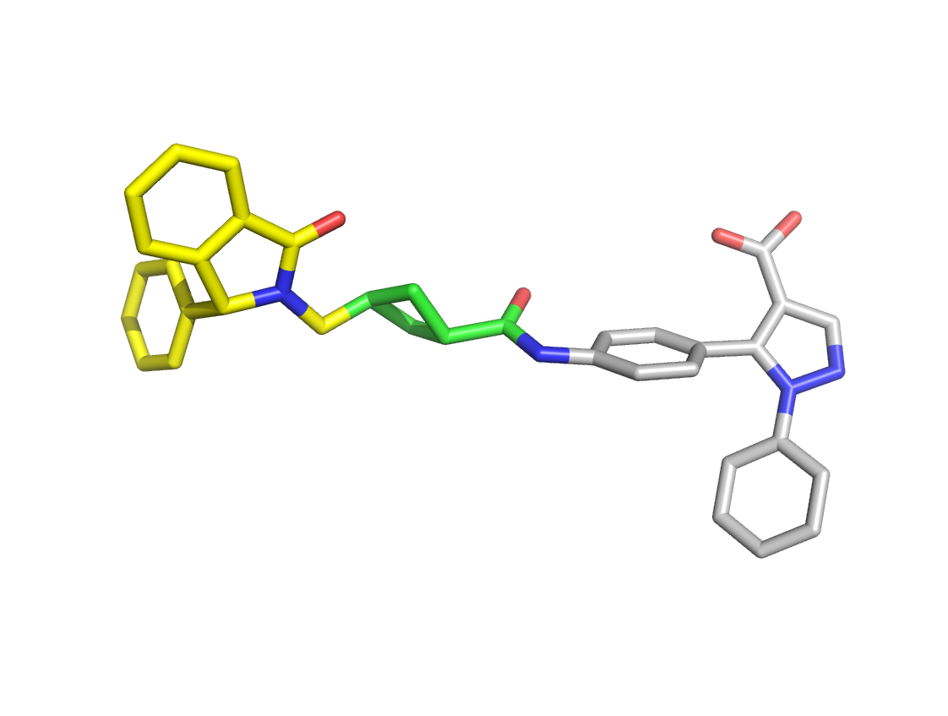
Fragment-Merging

Slide 33
Fragment-based screenings are often used as an alternative or complementary to HTS campaigns
Fragments are usually good starting points due to high ligand efficiency and good physico-chemical properties
Fragment follow-up is heavily dependent on structural information. Therefore FBS approaches are usually only pursued if a high-throughput X-ray system can be established

Slide 34
Case Study 1: Vemurafenib (Plexxikon)

Slide 35
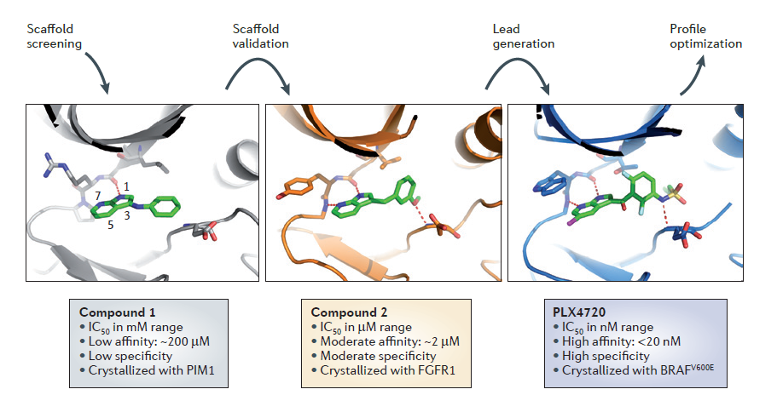

Slide 36
Vemurafenib

Slide 37
Case Study 2: BACE1 Inhibitor (Merck)

Slide 38
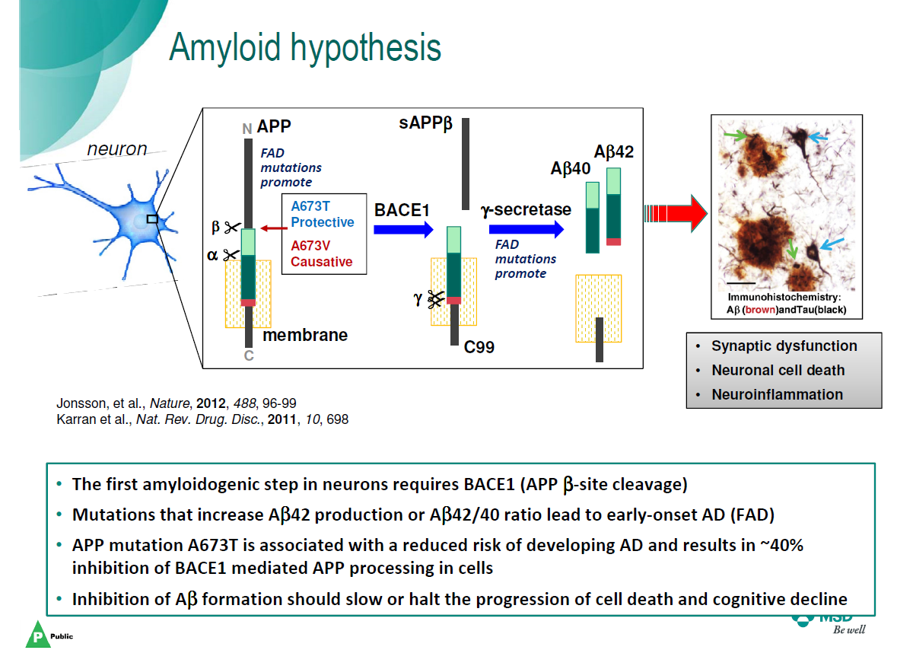

Slide 39
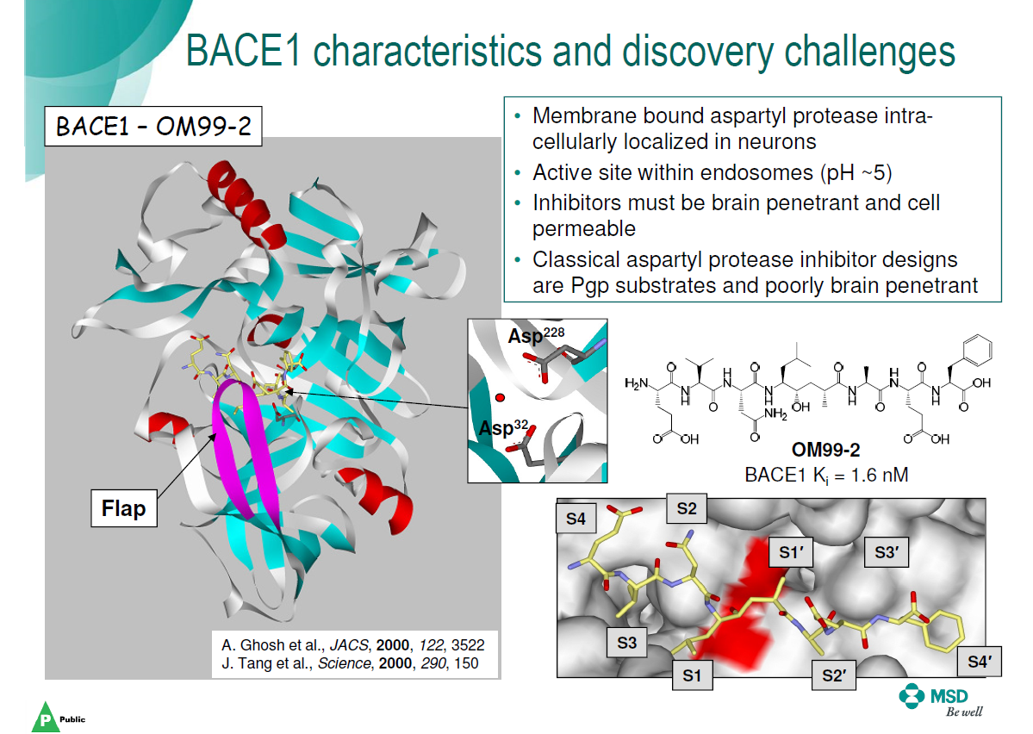

Slide 40
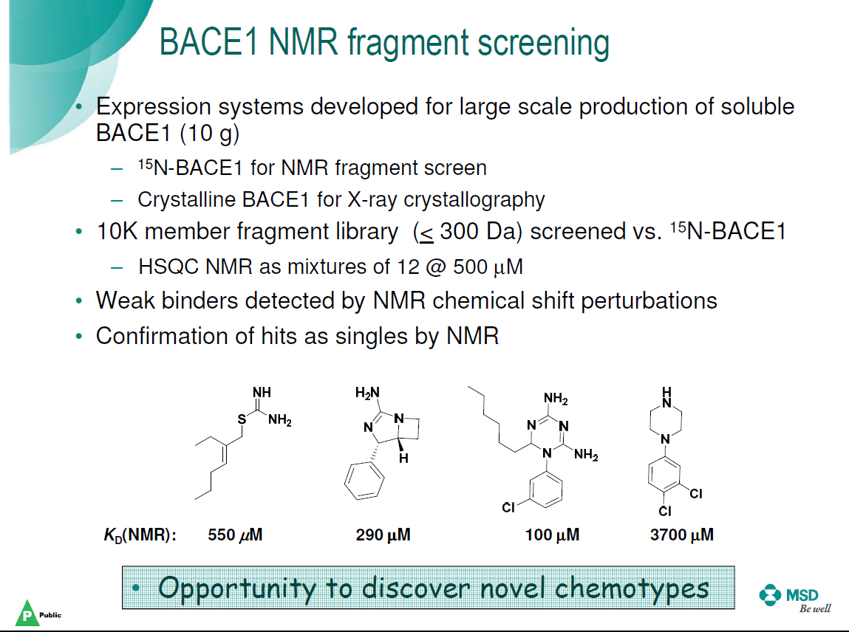

Slide 41
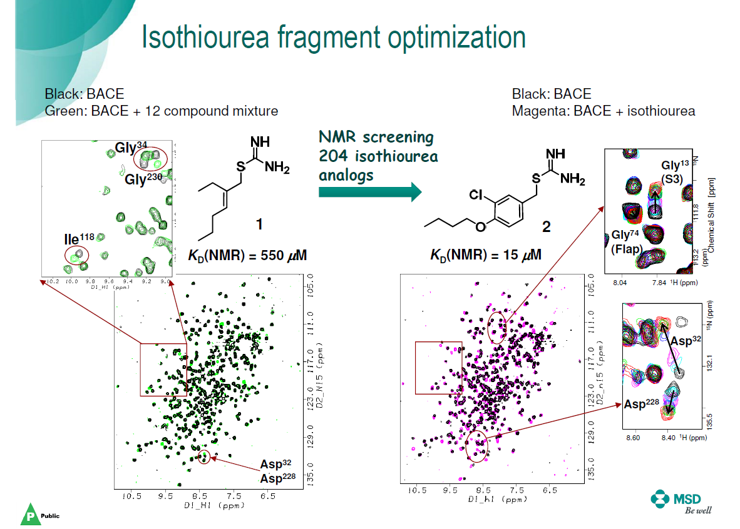

Slide 42
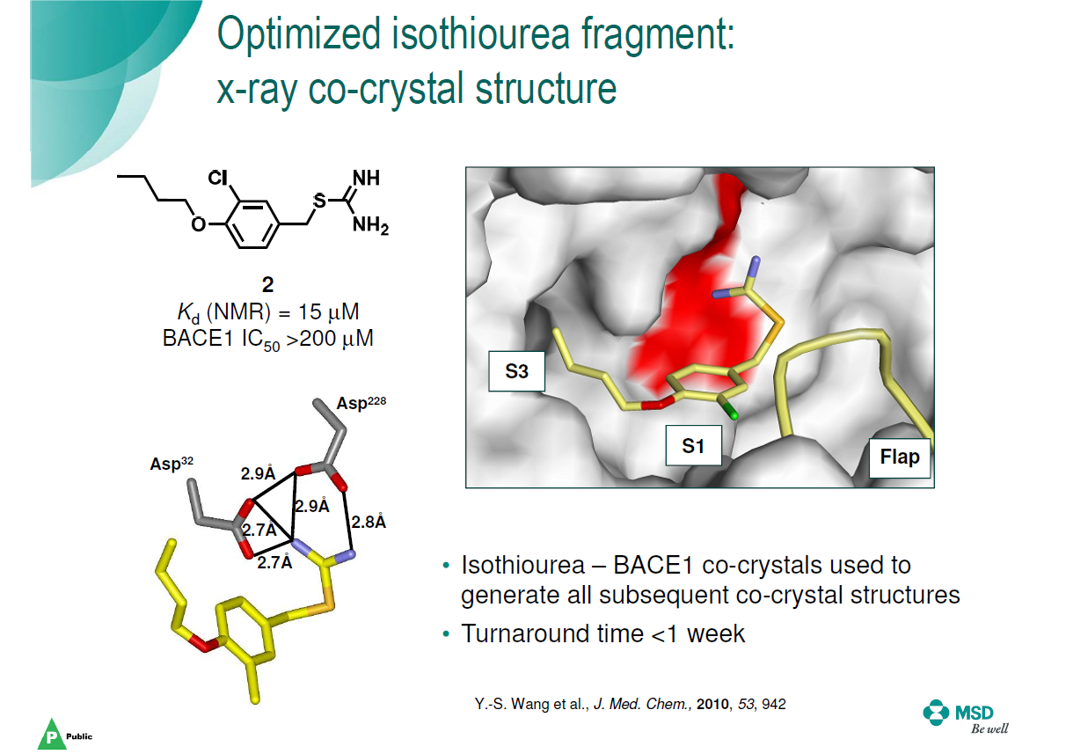

Slide 43
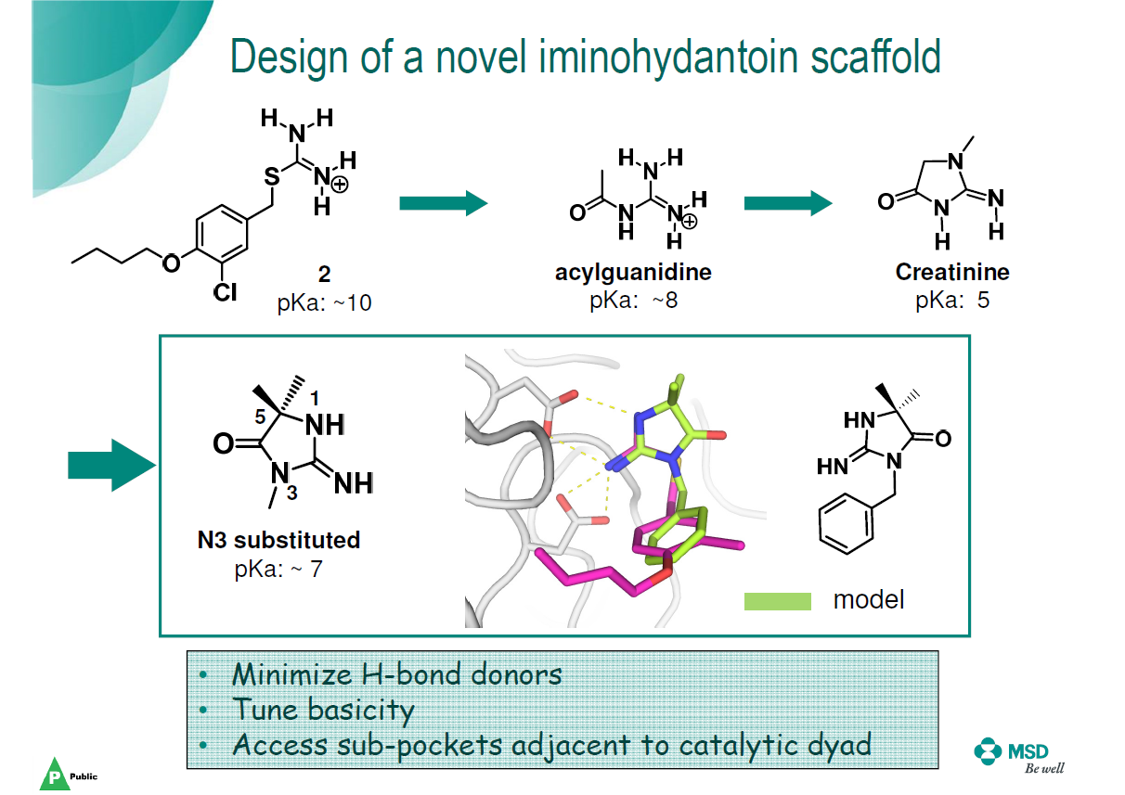

Slide 44
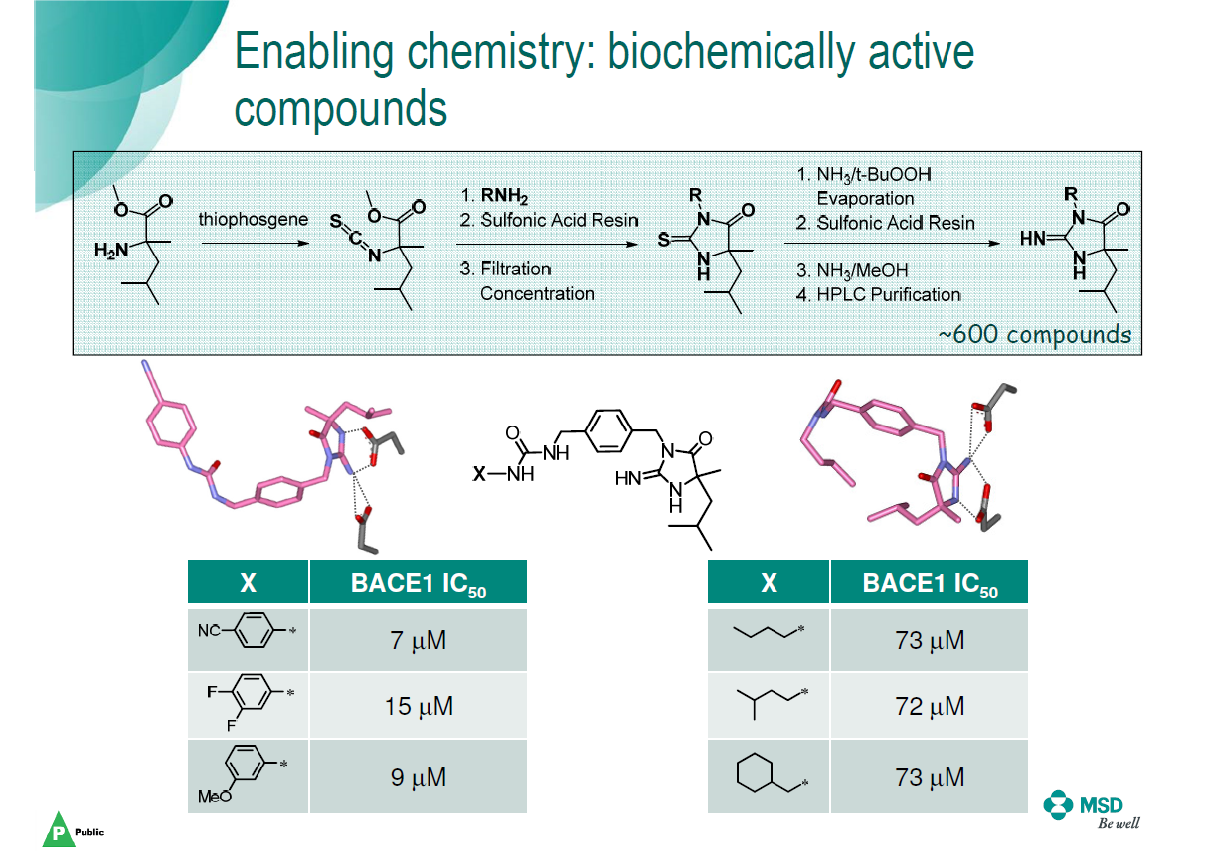

Slide 45
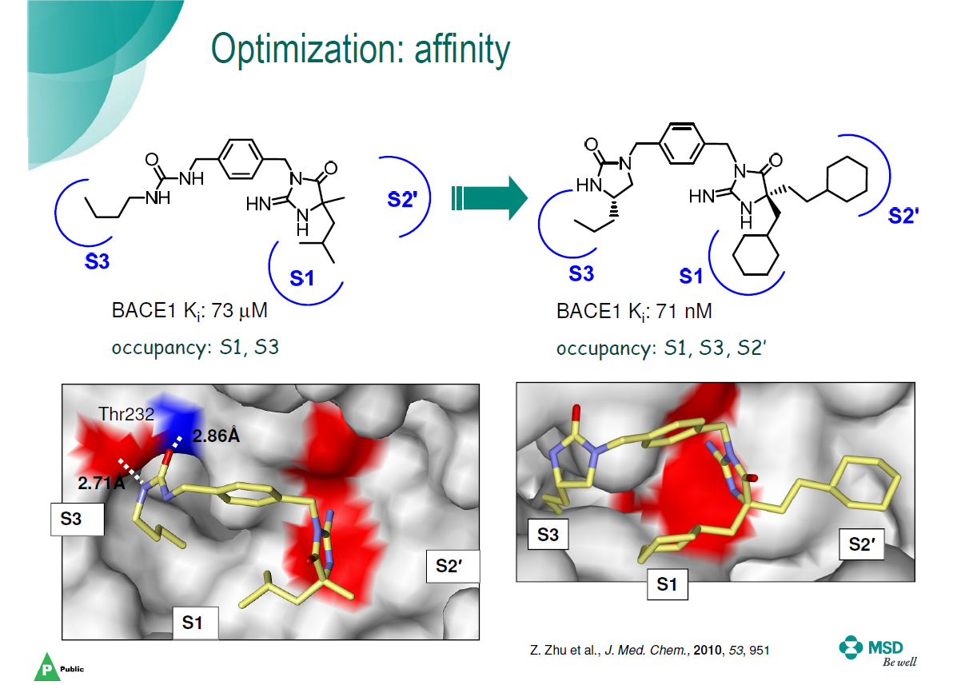

Slide 46
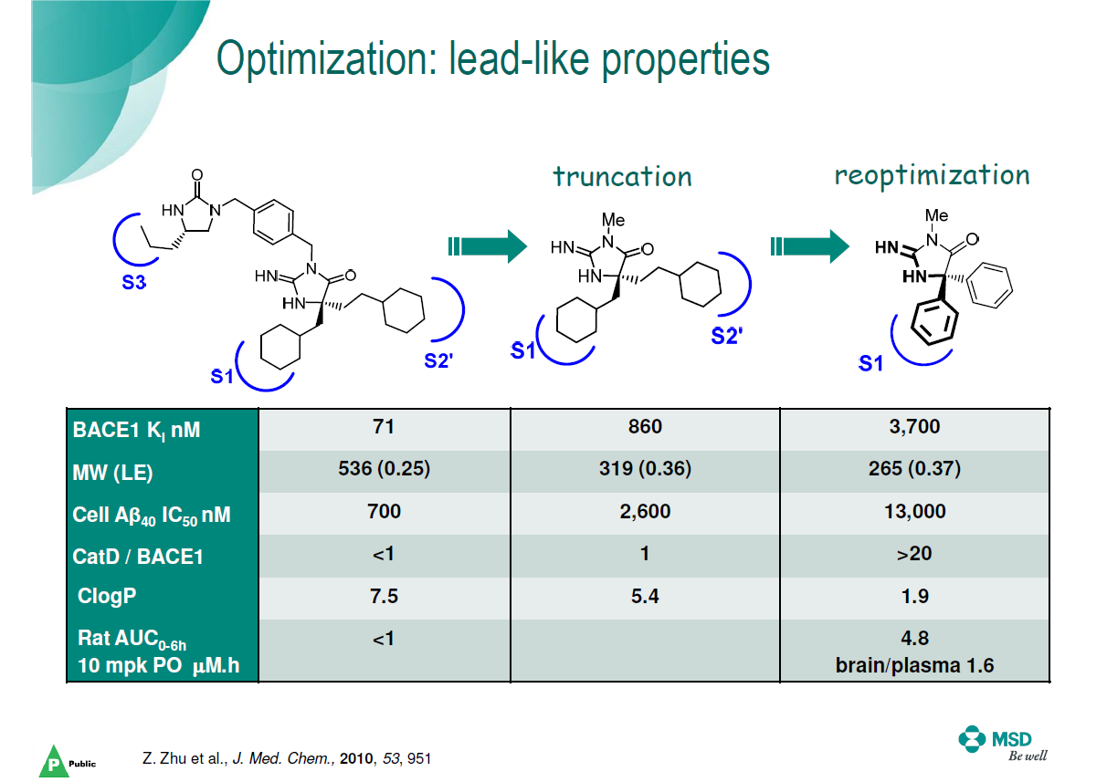

Slide 47
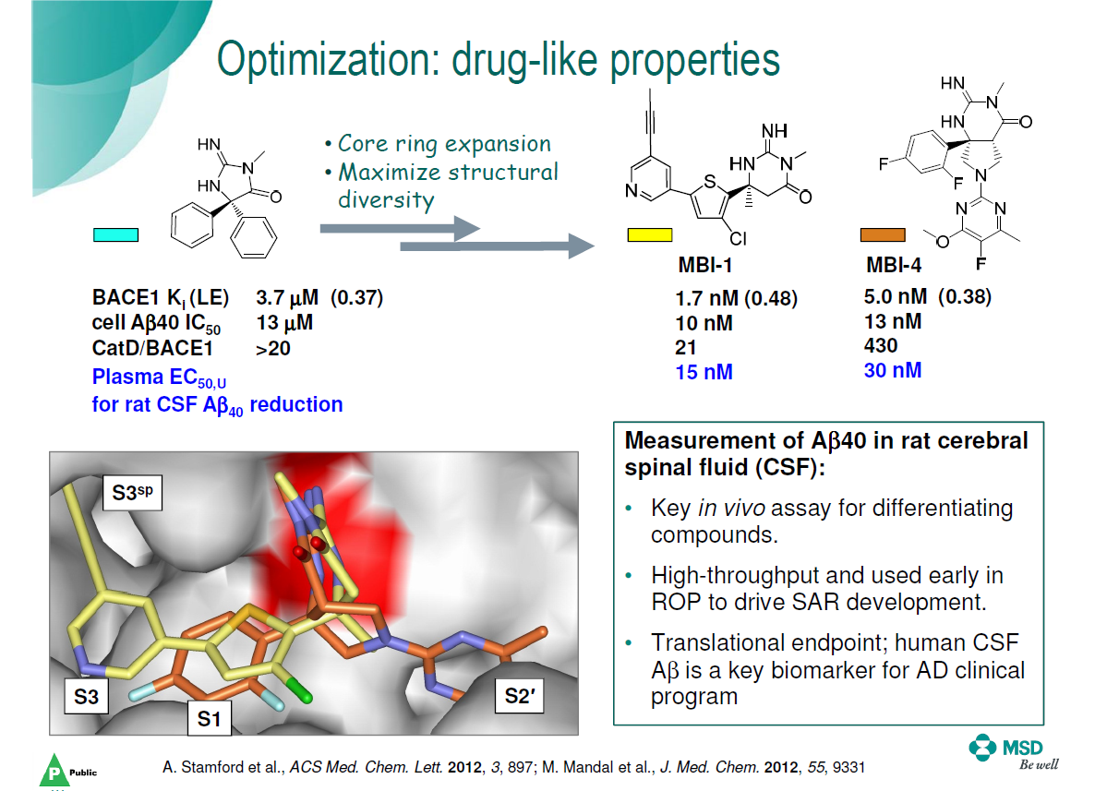

Slide 48


Slide 49


Slide 50


Slide 51


Slide 52


Slide 53
In February 2017, Merck halted its late-stage trial of verubecestat for mild to moderate Alzheimer's disease after it was reported as having "virtually no chance of finding a positive clinical effect" according to an independent panel of experts.^{[7]} The results of Merck's trial of verubecestat on patients with prodromal (early stage) Alzheimer's are still expected in February 2019.

Slide 54
Case Study 3: Eli Lilly BACE Inhibitor
IC50 = 8200 μM
LE = 0.41
IC50 =22 μM
LE = 0.48
IC50 =0.92 μM
LE = 0.43
IC50 =0.24 μM
LE = 0.43
IC50 = 790 μM
LE = 0.39
LY2811376
Discontinued in Phase II due to abnormal liver biochemistry values

Slide 55
Case Study 4: Vanderbilt MCL-1Inhibitor
K_{D} = 60 μM
LE = 0.38
K_{D} = 0.32 μM
LE = 0.35
K_{D} = 131 μM
LE = 0.41
K_{D} = 0.055 μM
LE = 0.38

Slide 56
Lecture 5d: DNA-encoded libraries

Slide 57
How to achieve better coverage of the chemical space?
1. Decrease molecule size -> Fragment-based drug discovery
2. Increase size of screening library

Slide 58
Conventional screening library:
One molecule per well
Each molecule needs to be separated, purified and registered
Molecule identification based on well position
Effort (cost and time) grows linearly with size of screening library

Slide 59

DNA
ACTGAG
Genetic Information:
Easy writable
Easy readable
Molecular Barcode

Slide 60


Slide 61

Buchwald-Coupling
Amide-Coupling
Suzuki-Coupling

Slide 62


Slide 63


Slide 64


Slide 65


